Slide 1


Customer Prediction Buying Behavior
Presented by Dinar Wahyu Rahman, Junior Data Scientist
10/07/2024

Slide 2
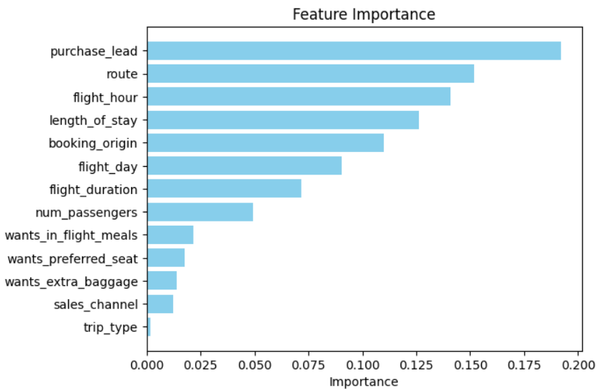
We have trained data with Random Forest Classifier, and obtained: Cross-validation accuracy scores: [0.8558 0.8514 0.8498 0.8534 0.8571] Mean accuracy score: 0.8535 Accuracy: 0.8538
RESULT
Evaluation
The most important variable in the model was purchase_lead.
The accuracy model was approximately 0.8538. I suggest adding more customer-centric features to the model.
Information about the flight, e.g. flight time and duration was also significant.

